Slide 1
Unearthing the environmental impact of human activity: A global Co2 emission analysis

Slide 2
Global warming
Global warming is the term used to describe the gradual rise in the Earth’s average surface temperature. This increase is mostly due to human activity.
Earth’s temperature are rising. This is because greenhouse gases(CO2) can absorb solar heat and stop it from escaping into space.

Slide 3
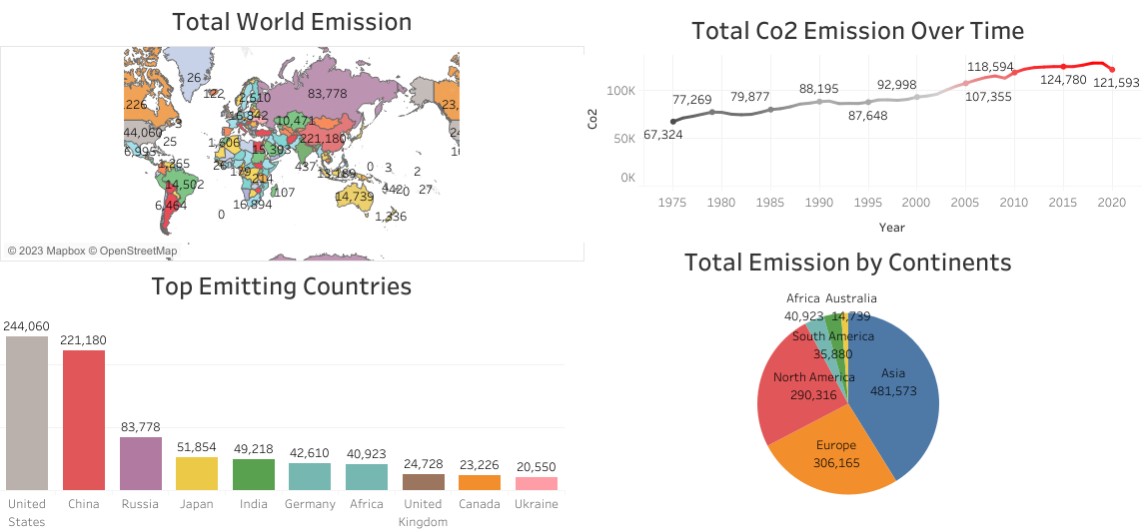

Slide 4
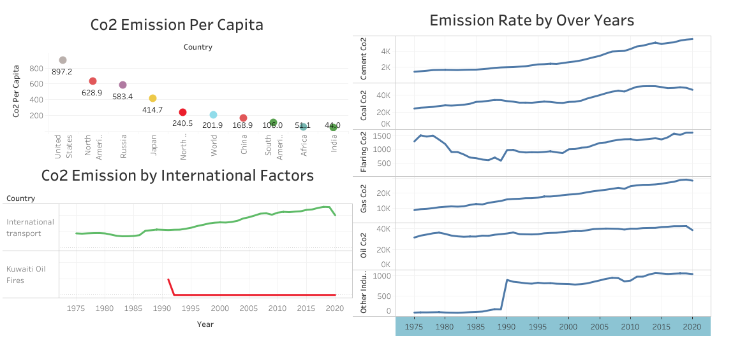

Slide 5
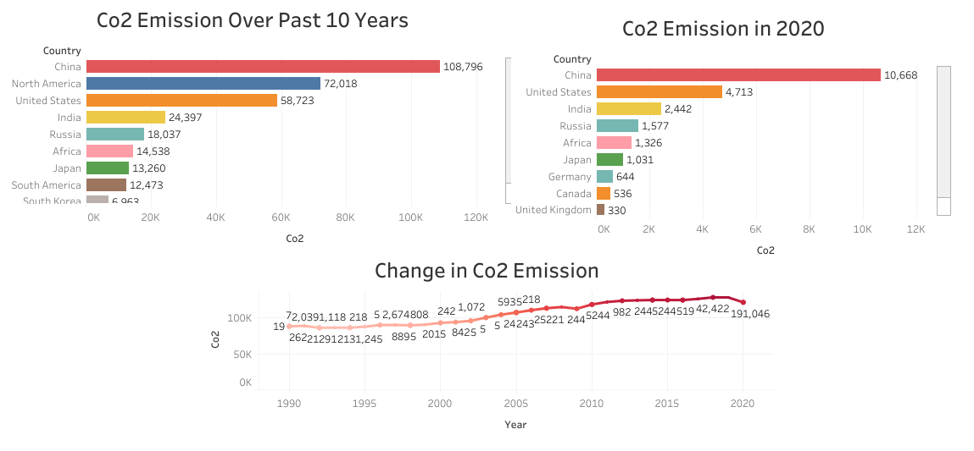

Slide 6
Measures to control Co2 Emission
Use renewable resources
Plant more trees
Bring reusable products
Avoid Plastic waste
Reduce waste
Eat less meat and animal products

